Slide 1

AWS CloudFront, Lambda, and CloudWatch: A Powerful Trio
This presentation will explore how AWS CloudFront, Lambda, and CloudWatch work together to enhance your web applications and deliver a superior user experience.
By,
Abran . A

Slide 2
CloudFront: Delivering Content Globally
Reduced Latency
Increased Availability
Cost Optimization
Content is delivered from locations closest to users, minimizing network hops and improving loading times.
CloudFront's edge locations offer high availability, ensuring consistent service even during peak traffic.
By caching frequently accessed content at the edge, CloudFront reduces bandwidth usage and costs.

Slide 3
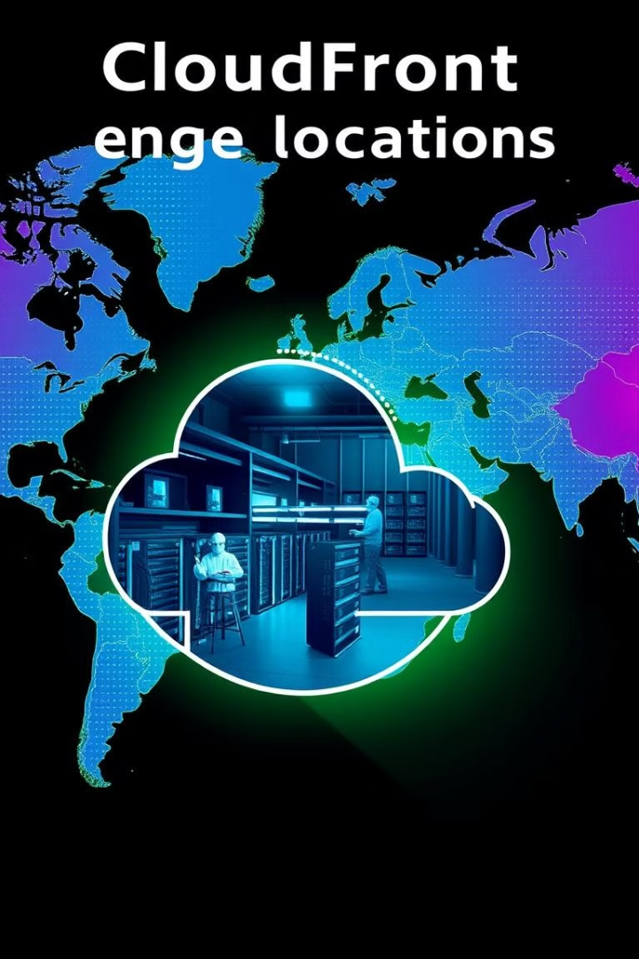
Edge Locations: Optimizing Performance
d
1
Global Reach
2
Geographic Proximity
CloudFront has a vast network of edge locations across the globe, enabling rapid delivery of content to users worldwide.
Edge locations are strategically placed in major regions, ensuring content is delivered from the nearest location to users, minimizing latency.
3
Content Caching
CloudFront caches frequently accessed content at the edge, reducing the need to fetch data from the origin server.

Slide 4
Lambda: Extending CloudFront Functionality
Dynamic Content
Customizations
Event-Driven Architecture
Lambda enables real-time manipulation of content, allowing for personalized experiences and dynamic content updates.
Execute custom logic at various stages of content delivery, including origin requests, viewer requests, and responses.
Lambda is triggered by events within CloudFront, such as requests and responses, enabling asynchronous processing.

Slide 5




Building a Basic Lambda Function
Function Creation
Event Handling
Create a Lambda function in the AWS console and select "Lambda@Edge" as the execution environment.
Define the trigger event that will execute the Lambda function, such as a CloudFront request or response.
Code Implementation
Write code within the Lambda function to perform the desired actions, such as modifying headers, rewriting URLs, or adding custom logic.

Slide 6
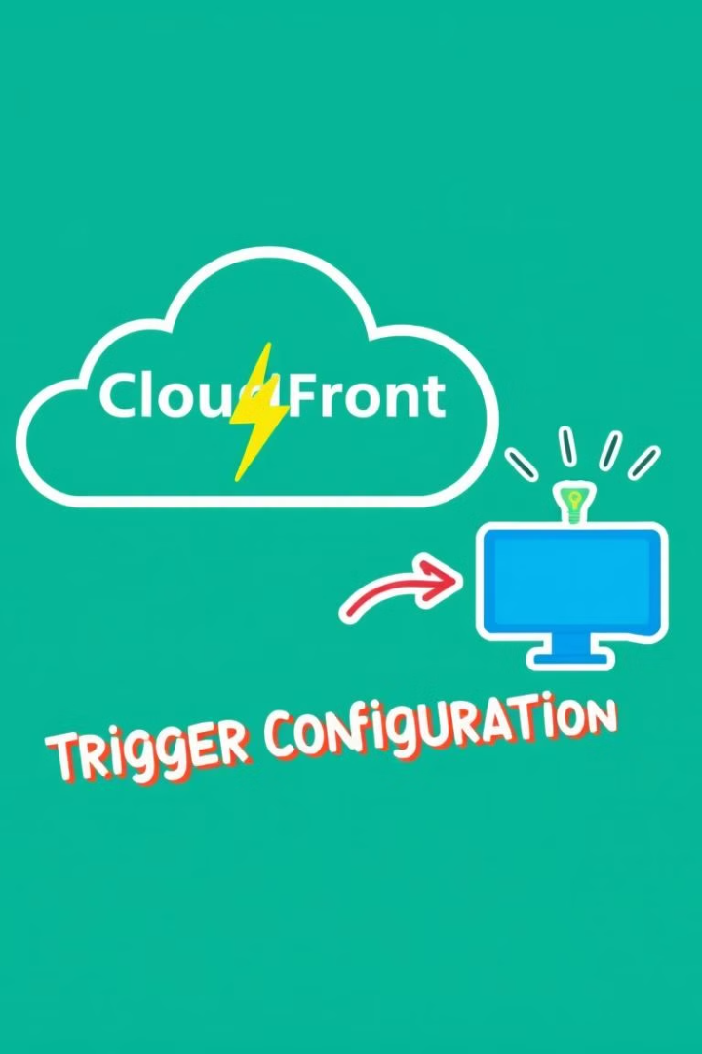
Triggering Lambda Functions with CloudFront
1
Viewer Request
Execute Lambda functions before or after requests are sent to the origin server.
d
2
Origin Response
Process the response from the origin server before it is sent back to the viewer.
3
Viewer Response
Modify the response sent to the viewer after it has been retrieved from the edge cache.

Slide 7
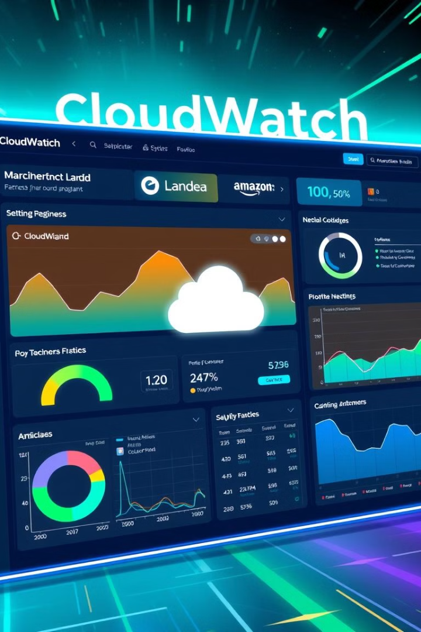



Monitoring and Logging with CloudWatch
Real-Time Monitoring
Track key metrics, such as request latency, error rates, and function execution time.
Log Aggregation
Collect and analyze logs from CloudFront and Lambda@Edge, providing insights into performance and troubleshooting.
Alerting
Set up alerts based on predefined thresholds, notifying you of potential issues and facilitating proactive maintenance.

Slide 8



Best Practices for Lambda
Minimize Code
1
Keep Lambda functions concise and focused, minimizing code size and execution time.
Efficient Caching
2
Leverage CloudFront's caching capabilities to reduce the need for frequent Lambda function invocations.
Error Handling
3
Implement robust error handling mechanisms to catch and log errors, improving stability and debugging.

Slide 9
Real-World Applications
Dynamic Content
1
Personalize content based on user location, preferences, or other factors.
Security Enhancements
2
Implement security checks and validation at the edge, protecting your application from attacks.
A/B Testing
3
Run experiments and test different versions of your content, optimizing user experience and performance.

Slide 10
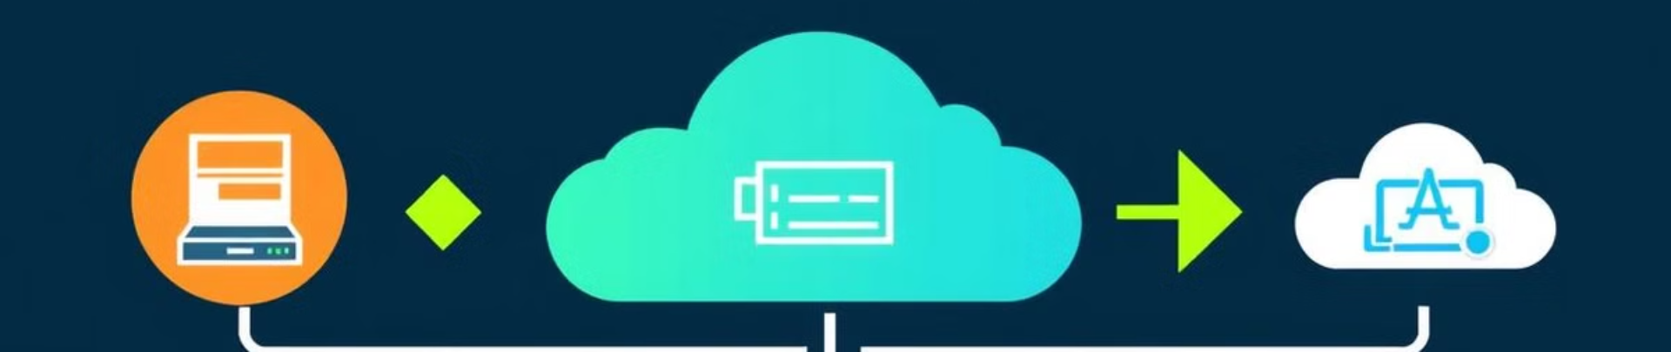
Key Takeaways
1
2
Scalable
Flexible
CloudFront, Lambda, and CloudWatch provide a scalable infrastructure for delivering dynamic content.
These services offer a flexible

